Slide 1
Indoor Proximity Information in Grocery Store
Group-05
Nitin
Sunand
Ushaswini

Slide 2
Introduction
This application focuses on using bluetooth beacons to provide indoor proximity
information in a grocery store environment.
Features
User can see the discounted items around him while shopping in the store
When the user is in the store, the app locates the closest beacon and present only the products for the region belonging to the closest beacon
If the app is unable to locate any beacons it will display all the discounted products sorted by region

Slide 3
API Design and Development
Microsoft - ASP.NET Identity Framework and JWT tokens to manage authentication and authorization
ASP.NET Web API is used to develop API for all features
Web APIs and Database are hosted in Microsoft Azure
Tables used are Regions and Discounts

Slide 4
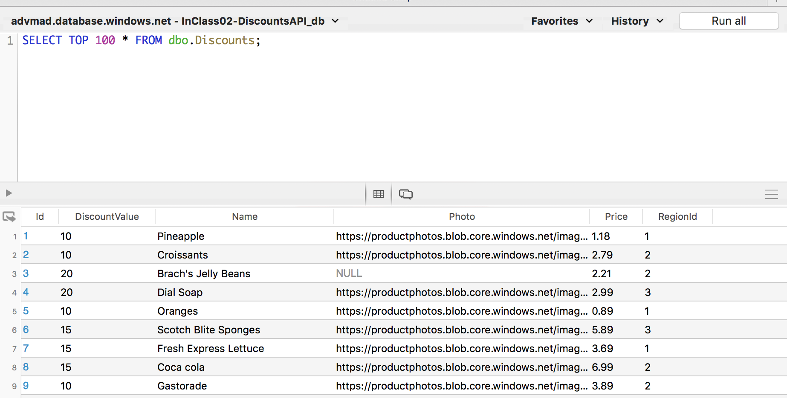
Table – Discounts
Columns:
Id
DiscountValue
Name
Photo
Price
RegionId

Slide 5
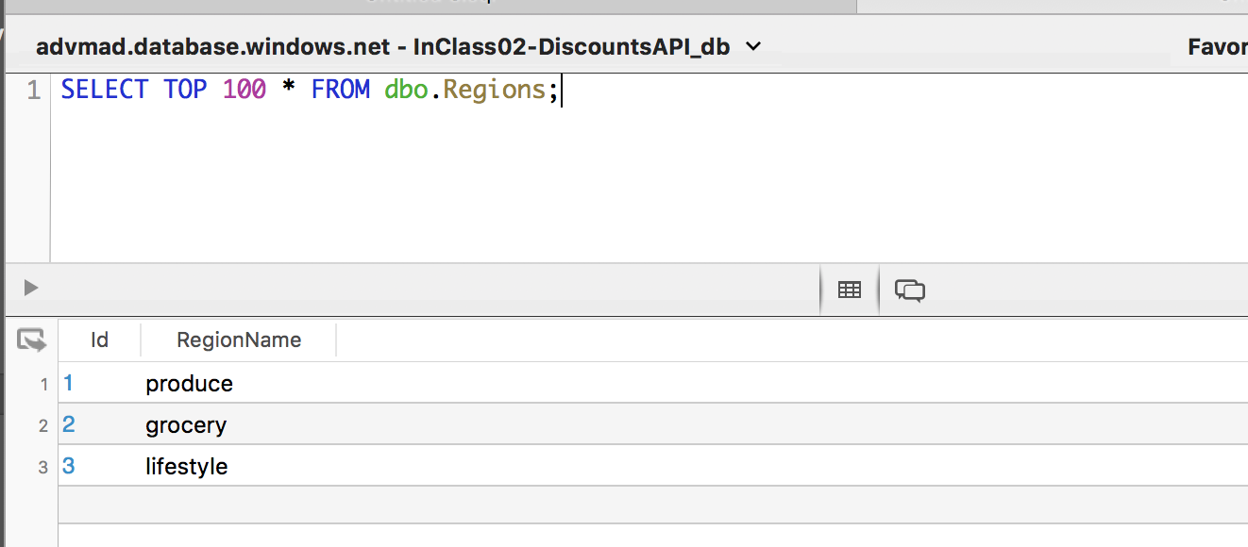
Regions – Seeded with initial data for 3 regions
Columns
Id
RegionName

Slide 6
API End Points
Base Url - http://inclass02-discountsapi.azurewebsites.net/
Discounts by RegionName - api/Discounts?regionName={name}
Discounts by RegionId - api/Discounts?regionId={id}
Get All Regions - api/Regions

Slide 7
Roles
Name | Role
Nitin | Android App Development
Sunand | Deploying API, Documentation
Ushaswini | API Development, Xamarin App,

Slide 8
Tasks - Completed
Web App for API Demo
Postman Files
Android Application
API Development
Deploying to Azure
Tasks - In Progress
Demo Video

